Slide 1
M05 - Project Design Presentation
Team FEED DEAD BEEF

Slide 2
Design Goals and Assumptions
Goals:
To be able to simulate both cache memory within the same application
To give the simulation statistics to the user about each type memory
To have the system be multicore
Assumptions
User will be given predefined memory files and trace file

Slide 3
System and Component Interactions
Python for user interaction
hash, heap, mm, stride, or trace options
Descriptions of tests
Summary of results
ADA for memory simulation
Individual testing of memory types
Generates log files and statistics

Slide 4
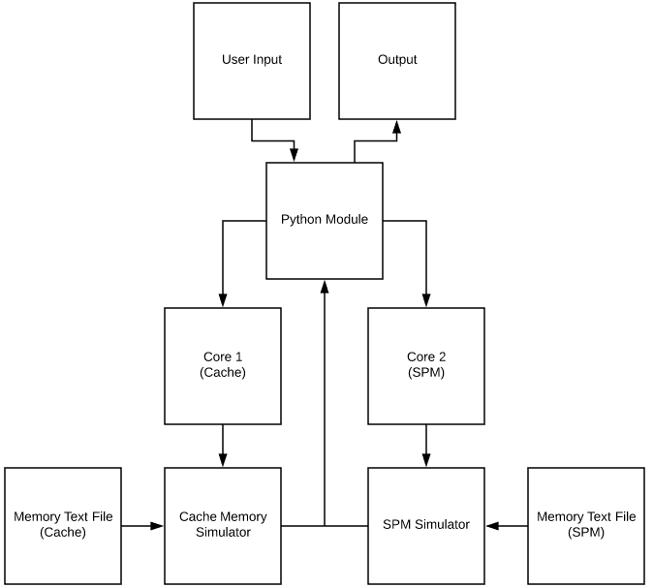
Logic and Structure

Slide 5
Performance
Multiple tests can be run using the same memory file.
Scratchpad and cache simulations are run concurrently on multiple cores.
The simulation will not take longer than one minute for any test.
Simulation statistics will be shown in the command window once the simulations have finished.
Log files will we overwritten when the next test is run.

Slide 6
Interface and Usability
The application will be a Python script that is launched in a terminal window
Application will prompt user about what kind of simulation they would like to run
Python will call memsim program
Memsim program will output results to log file to be grabbed by Python script
Cache needs following parameters:
memory: The contained memory.
line_count: The number of cache lines (1).
line_size: The size of each cache line in bytes (8).
associativity: The set associativity of the cache (1).
latency: The latency (3).

Slide 7
Interface and Usability
Scratchpad needs the following parameters:
memory: The contained memory.
size: The size of the scratchpad in bytes (defaults to 0).
latency: The latency of a hit in the scratchpad.
The trace file will contain read, write, idle time commands in sequence.
Format: R<address>:<size>, W<address>:<size>, I<cycles>.
For read and write commands (denoted as R and W respectively),
<address> is the address in hexadecimal
<size> is the size of the memory access in hexadecimal
idle command (I), <cycles> is the number of nop cycles in hexadecimal.
Ways to simulate the memory: hash, heap, mm, stride, or trace

Slide 8
Testability and Maintenance
hash: A benchmark to generate random 4-byte memory accesses.
heap: A benchmark to perform random insertions and deletions of 4-byte items in a full binary heap.
mm: A benchmark to simulate matrix-matrix multiplication on 4-byte values.
stride: A benchmark to perform strided 4-byte memory accesses.
trace: A benchmark to execute a memory access trace
Closed system with only 2 files to change: memory and trace files

Slide 9
References
Wingbermuehle, Joe. “Memory Simulator and Optimizer.” Memsim, Github Repository, 24 Sept. 2013, github.com/joewing/memsim.
“CAS latency.” Wikipedia, Wikimedia Foundation, 13 Feb. 2018, en.wikipedia.org/wiki/CAS_latency.

